Slide 1
Aquatic Monitoring System
GROUP 14:
Aamani Mannava
Aparna Kanakamedala
Ananya Yendluri
Dev Vrat Pandey
Nishta Jain

Slide 2
INTRODUCTION
Aquariums and aquatic environments provide captivating ecosystems teeming with life. Maintaining the health and well-being of aquatic creatures within these habitats is a complex task.
Aquariums demand precise water parameter monitoring to ensure the health of aquatic life.
Variations in water temperature, pH levels, and water quality can have a profound impact on the overall vitality of the ecosystem.

Slide 3
AGENDA
Problem statement
Overview
Objective and scope
Project architecture
Hardware and software requirements
Connections of temperature sensor and TDS water quality sensor

Slide 4
PROBLEM STATEMENT
Existing water parameter monitoring solutions lack automation, accuracy, and real-time alerting capabilities.
Users face challenges in ensuring precise measurements, timely detection of issues, and historical data analysis.
The absence of user-friendly interfaces hinders effective interaction with monitoring systems.

Slide 5
PROJECT OVERVIEW
This project aims to develop an advanced and automated water parameter monitoring system utilizing BeagleBone technology. The system will continuously assess and record critical water parameters, including temperature and pH levels, in aquatic environments. The collected data will be logged for historical analysis, providing users with valuable insights into the health of their aquatic ecosystems. Additionally, the system will be equipped with alerting capabilities to promptly notify users of any deviations from predefined parameter ranges.

Slide 6
OBJECTIVE AND SCOPE
Develop a user-friendly interface for real-time data visualization.
Implement accurate data collection from temperature and water quality monitoring sensors.
Create a robust data logging system for historical analysis.
Design an alerting mechanism for immediate user notifications.
Provide insights into aquatic ecosystem health through data analysis.

Slide 7
PROJECT ARCHITECTURE
01
Water Quality
Temperature
Parameter Monitoring
02
Enables long term analysis
Provides information about ecosystem health trends
Data Logging
03
Real time Alerts
Early warnings when something is not right
Alert Mechanism

Slide 8
HARDWARE REQUIREMENTS
BeagleBone Board: BeagleBone will serve as the core processing unit, responsible for data collection, storage, and interfacing with sensors.
Sensors:
Temperature Sensor: DS18B20, for accurate temperature measurements
Water Quality Sensor: TDS Meter Water Quality Sensor, capable of precise water quality detection measurements in aquatic environments
Display and User Interface:
LCD Display: A small LCD screen to display real-time data and system status
LEDs: To display system status

Slide 9
SOFTWARE REQUIREMENTS
Operating System: Windows
Programming Language: C
Sensor Interface: Appropriate libraries and interfaces to communicate with and collect data from the sensors
Data Logging: MYSQL for data storage
Alert System: Continuously monitor sensor data and trigger notifications via email when parameters fall outside predefined ranges

Slide 10
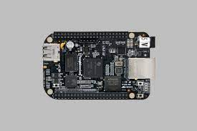
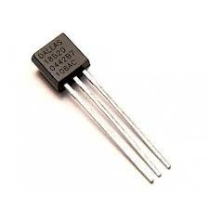
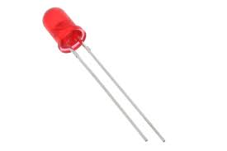
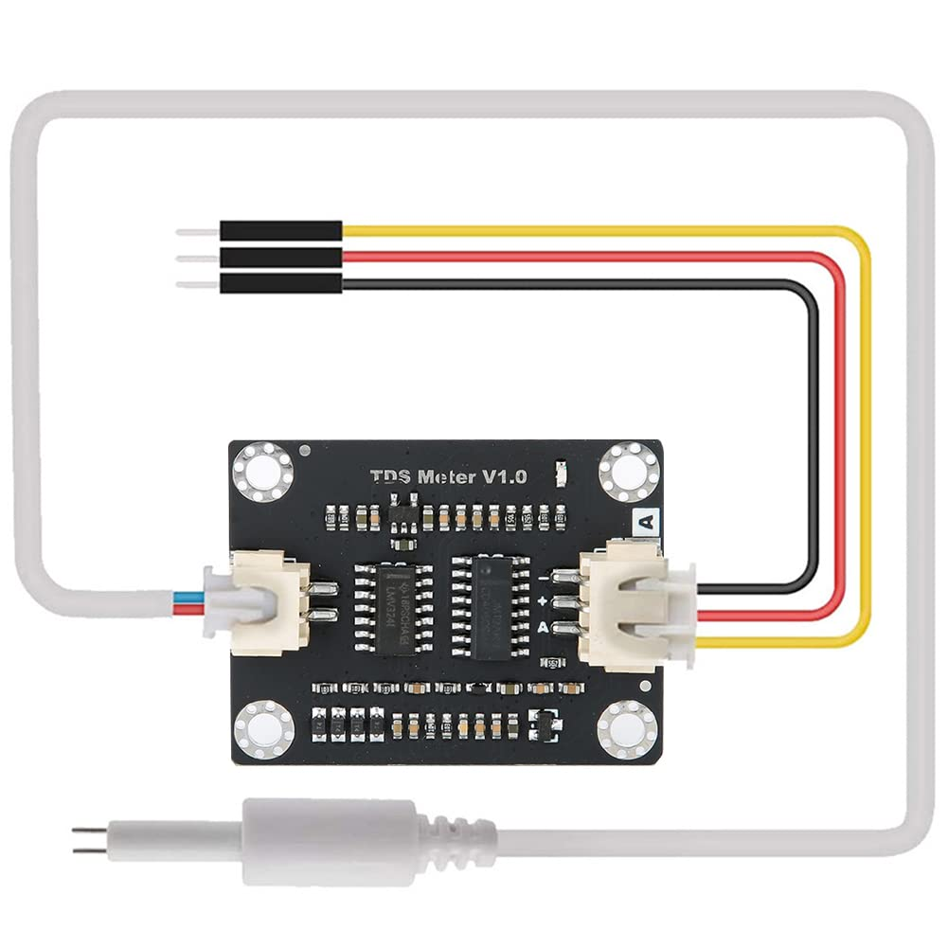
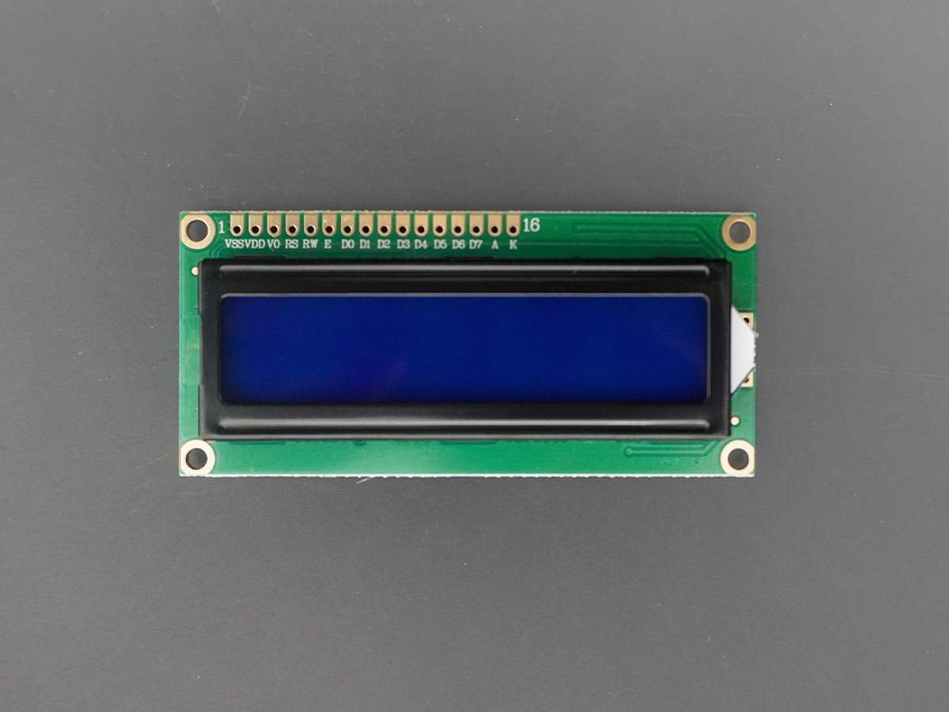
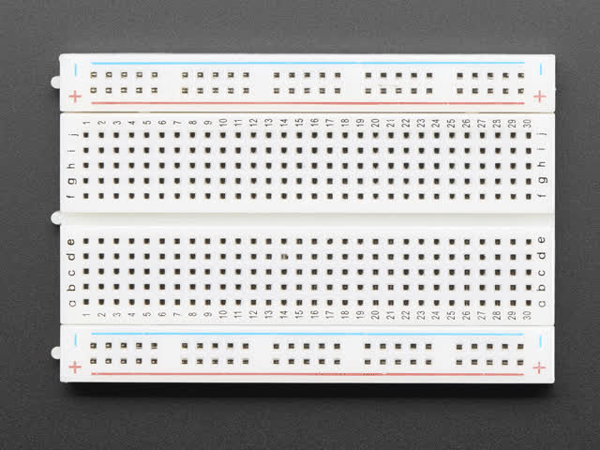
HARDWARE ARCHITECTURE
INPUT
OUTPUT

Slide 11
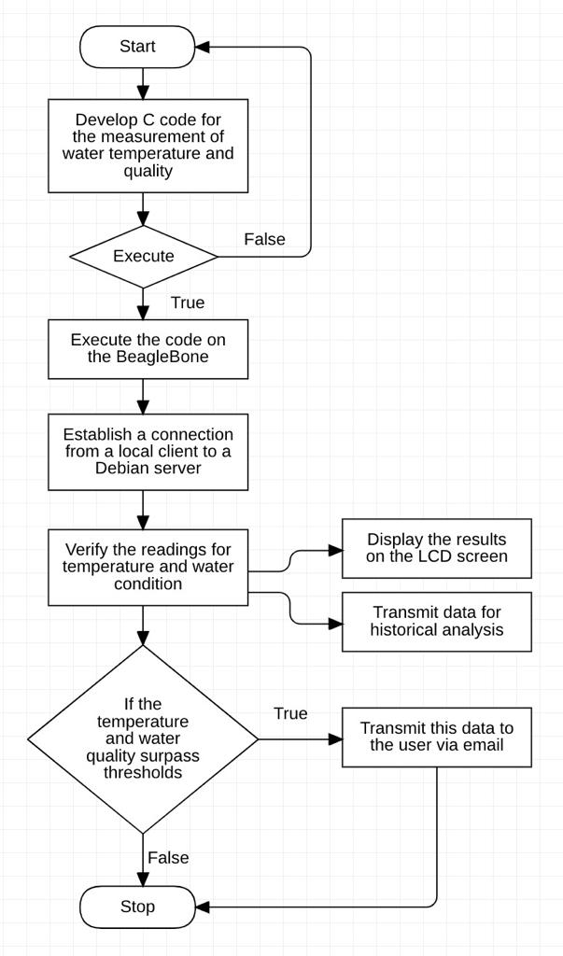
Software Flow chart

Slide 12
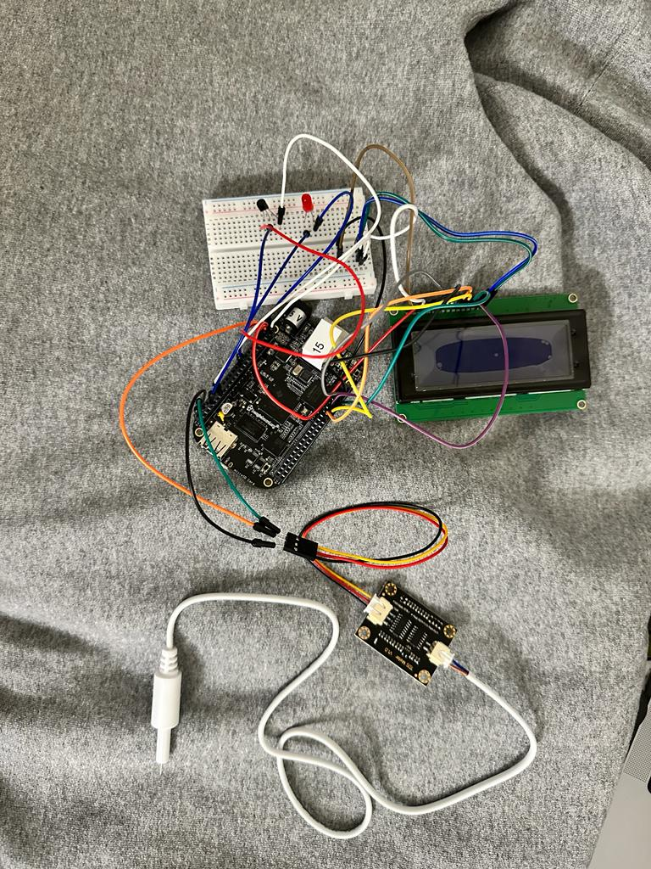
Project Progress
Connected Temperature sensor(DS18B20) and TDS water quality sensor to beaglebone using breadboard
Got output values for these sensors
Connected the LCD display and LED for the output

Slide 13
Next Steps
Complete the code for interfacing with sensors, enhancing data accuracy and reliability.
Show output on LCD and LED blinks when threshold surpasses and send that data for historical analysis
Progress in developing data visualization features for the LCD display, providing more detailed and informative sensor data displays

Slide 14
THANK YOU

